Slide 1


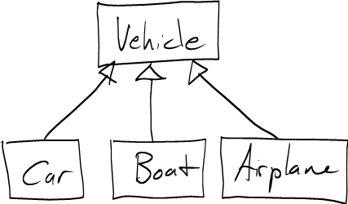

Inheritance
Extending Classes
Java OOP
Basics
SoftUni Team
Technical Trainers
Software University
http://softuni.bg

Slide 2

Table of Contents
Inheritance
Class Hierarchies
Inheritance in Java
Accessing Members of the Base Class
When to Use Inheritance
Composition
2

Slide 3
Questions
sli.do #java-fund
2

Slide 4
Inheritance
Extending Classes

Slide 5
Inheritance
Superclass - Parent class, Base Class
The class giving its members to its child class
Subclass - Child class, Derived Class
The class taking members from its base class
Base
Superclass
Derived
Subclass
<number>
Notes:
(c) 2007 National Academy for Software Development - http://academy.devbg.org. All rights reserved. Unauthorized copying or re-distribution is strictly prohibited.*
<number>##

Slide 6
Inheritance – Example
Base class
Person
+Name: String
+Address: String
Derived class
Derived class
Employee
Student
+Company: String
+School: String
5

Slide 7
Class Hierarchies
Inheritance leads to hierarchies of classes and/or interfaces in an application:
Base classes hold common characteristics
Game
SinglePlayerGame
MultiplePlayersGame
Minesweeper
Solitaire
BoardGame
…
…
Chess
Backgammon
<number>

Slide 8
Class Hierarchies – Java Collection
Iterable
Collection
List
Queue
Set
ArrayList
PriorityQueue
HashSet
LinkedList
LinkedHashSet
Vector
Deque
SortedSet
Stack
ArrayDeque
TreeSet
<number>

Slide 9
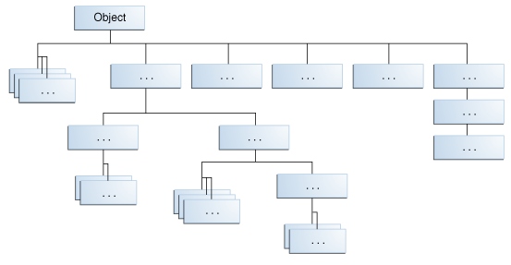
Java Platform Class Hierarchy
Object is at the root of Java Class Hierarchy
<number>

Slide 10
Inheritance in Java
Java supports inheritance through extends keyword
class Person { … }
class Student extends Person { … }
class Employee extends Person { … }
Person
Student extends person
Student
Employee
<number>
Notes:
(c) 2005 National Academy for Software Development - http://academy.devbg.org. All rights reserved. Unauthorized copying or re-distribution is strictly prohibited.(c) 2006 National Academy for Software Development - http://academy.devbg.org*
<number>##
Extensibility / Polymorphism: New functionality may be easily plugged in without changing existing classes as long the new plug-in classes extend given base classes.
Reusability: For a set of similar applications a framework can be defined using a core set of classes that are to be extended by classes that fill in the application-dependent part.
Information Hiding: If a more general class using a simpler contract is sufficient, details from extending classes may be hidden to some of the client classes. This allows them to be more independent from possible changes and diminishes the load of contracts that must be understood by a reader of these client classes.
*
07/16/96
(c) 2006 National Academy for Software Development - http://academy.devbg.org*
<number>##

Slide 11
Inheritance - Derived Class
Class takes all members from another class
Reusing Person
Person
Mother : Person
Father : Person
Student
Employee
School: School
Org: Organization
<number>
Notes:
© Software University Foundation – http://softuni.org
This work is licensed under the Creative Commons Attribution-NonCommercial-ShareAlike license.
<number>

Slide 12
Using Inherited Members
You can access inherited members as usual
class Person { public void sleep() { … } }
class Student extends Person { … }
class Employee extends Person { … }
Student student = new Student();
student.sleep();
Employee employee = new Employee();
employee.sleep();
<number>
Notes:
(c) 2005 National Academy for Software Development - http://academy.devbg.org. All rights reserved. Unauthorized copying or re-distribution is strictly prohibited.(c) 2006 National Academy for Software Development - http://academy.devbg.org*
<number>##
Extensibility / Polymorphism: New functionality may be easily plugged in without changing existing classes as long the new plug-in classes extend given base classes.
Reusability: For a set of similar applications a framework can be defined using a core set of classes that are to be extended by classes that fill in the application-dependent part.
Information Hiding: If a more general class using a simpler contract is sufficient, details from extending classes may be hidden to some of the client classes. This allows them to be more independent from possible changes and diminishes the load of contracts that must be understood by a reader of these client classes.
*
07/16/96
(c) 2006 National Academy for Software Development - http://academy.devbg.org*
<number>##

Slide 13
Reusing Constructors
Constructors are not inherited
Constructors can be reused by the child classes
class Student extends Person {
private School school;
public Student(String name, School school) {
super(name);
this.school = school;
}
}
Constructor call should be first
13
Notes:
(c) 2005 National Academy for Software Development - http://academy.devbg.org. All rights reserved. Unauthorized copying or re-distribution is strictly prohibited.(c) 2006 National Academy for Software Development - http://academy.devbg.org*
<number>##
Extensibility / Polymorphism: New functionality may be easily plugged in without changing existing classes as long the new plug-in classes extend given base classes.
Reusability: For a set of similar applications a framework can be defined using a core set of classes that are to be extended by classes that fill in the application-dependent part.
Information Hiding: If a more general class using a simpler contract is sufficient, details from extending classes may be hidden to some of the client classes. This allows them to be more independent from possible changes and diminishes the load of contracts that must be understood by a reader of these client classes.
*
07/16/96
(c) 2006 National Academy for Software Development - http://academy.devbg.org*
<number>##

Slide 14
Thinking About Inheritance - Extends
Derived class instance contains instance of its base class
Student (Derived Class)
+study():void
Employee (Derived Class)
+work():void
Person (Base Class)
+sleep():void
<number>
Notes:
© Software University Foundation – http://softuni.org
This work is licensed under the Creative Commons Attribution-NonCommercial-ShareAlike license.
<number>

Slide 15
Inheritance
Inheritance has a transitive relation
class Person { … }
class Student extends Person { … }
class CollegeStudent extends Student { … }
Person
Student
CollegeStudent
<number>
Notes:
(c) 2005 National Academy for Software Development - http://academy.devbg.org. All rights reserved. Unauthorized copying or re-distribution is strictly prohibited.(c) 2006 National Academy for Software Development - http://academy.devbg.org*
<number>##
Extensibility / Polymorphism: New functionality may be easily plugged in without changing existing classes as long the new plug-in classes extend given base classes.
Reusability: For a set of similar applications a framework can be defined using a core set of classes that are to be extended by classes that fill in the application-dependent part.
Information Hiding: If a more general class using a simpler contract is sufficient, details from extending classes may be hidden to some of the client classes. This allows them to be more independent from possible changes and diminishes the load of contracts that must be understood by a reader of these client classes.
*
07/16/96
(c) 2006 National Academy for Software Development - http://academy.devbg.org*
<number>##

Slide 16
Multiple Inheritance
In Java there is no multiple inheritance
Only multiple interfaces can be implemented
Person
Student
CollegeStudent
<number>
Notes:
(c) 2005 National Academy for Software Development - http://academy.devbg.org. All rights reserved. Unauthorized copying or re-distribution is strictly prohibited.(c) 2006 National Academy for Software Development - http://academy.devbg.org*
<number>##
Extensibility / Polymorphism: New functionality may be easily plugged in without changing existing classes as long the new plug-in classes extend given base classes.
Reusability: For a set of similar applications a framework can be defined using a core set of classes that are to be extended by classes that fill in the application-dependent part.
Information Hiding: If a more general class using a simpler contract is sufficient, details from extending classes may be hidden to some of the client classes. This allows them to be more independent from possible changes and diminishes the load of contracts that must be understood by a reader of these client classes.
*
07/16/96
(c) 2006 National Academy for Software Development - http://academy.devbg.org*
<number>##

Slide 17
Access to Base Class Members
Use the super keyword
class Person { … }
class Employee extends Person {
void fire(String reasons) {
System.out.println( super.name + " got fired because " + reasons);
}
}
<number>
Notes:
(c) 2005 National Academy for Software Development - http://academy.devbg.org. All rights reserved. Unauthorized copying or re-distribution is strictly prohibited.(c) 2006 National Academy for Software Development - http://academy.devbg.org*
<number>##
Extensibility / Polymorphism: New functionality may be easily plugged in without changing existing classes as long the new plug-in classes extend given base classes.
Reusability: For a set of similar applications a framework can be defined using a core set of classes that are to be extended by classes that fill in the application-dependent part.
Information Hiding: If a more general class using a simpler contract is sufficient, details from extending classes may be hidden to some of the client classes. This allows them to be more independent from possible changes and diminishes the load of contracts that must be understood by a reader of these client classes.
*
07/16/96
(c) 2006 National Academy for Software Development - http://academy.devbg.org*
<number>##

Slide 18
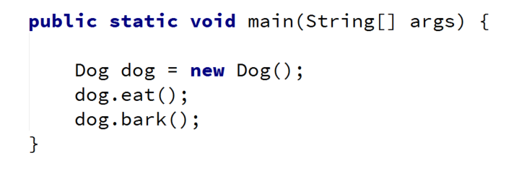
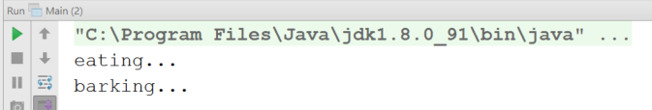
Problem: Single Inheritance
Animal
+eat():void
Dog
+bark():void
<number>
Notes:
(c) 2005 National Academy for Software Development - http://academy.devbg.org. All rights reserved. Unauthorized copying or re-distribution is strictly prohibited.(c) 2006 National Academy for Software Development - http://academy.devbg.org*
<number>##
Extensibility / Polymorphism: New functionality may be easily plugged in without changing existing classes as long the new plug-in classes extend given base classes.
Reusability: For a set of similar applications a framework can be defined using a core set of classes that are to be extended by classes that fill in the application-dependent part.
Information Hiding: If a more general class using a simpler contract is sufficient, details from extending classes may be hidden to some of the client classes. This allows them to be more independent from possible changes and diminishes the load of contracts that must be understood by a reader of these client classes.
*
07/16/96
(c) 2006 National Academy for Software Development - http://academy.devbg.org*
<number>##

Slide 19
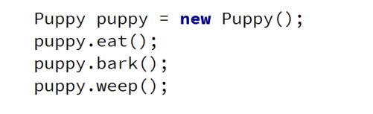
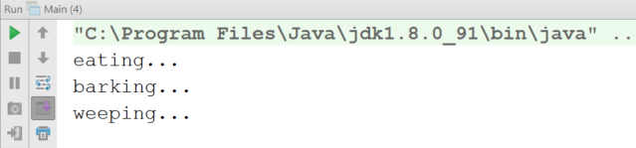
Problem: Multilevel Inheritance
Animal
+eat():void
Dog
+bark():void
Puppy
+weep():void
<number>
Notes:
(c) 2005 National Academy for Software Development - http://academy.devbg.org. All rights reserved. Unauthorized copying or re-distribution is strictly prohibited.(c) 2006 National Academy for Software Development - http://academy.devbg.org*
<number>##
Extensibility / Polymorphism: New functionality may be easily plugged in without changing existing classes as long the new plug-in classes extend given base classes.
Reusability: For a set of similar applications a framework can be defined using a core set of classes that are to be extended by classes that fill in the application-dependent part.
Information Hiding: If a more general class using a simpler contract is sufficient, details from extending classes may be hidden to some of the client classes. This allows them to be more independent from possible changes and diminishes the load of contracts that must be understood by a reader of these client classes.
*
07/16/96
(c) 2006 National Academy for Software Development - http://academy.devbg.org*
<number>##

Slide 20
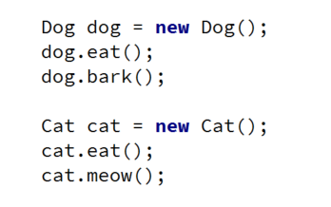
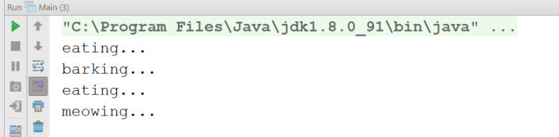
Problem: Hierarchical Inheritance
Animal
+eat():void
Dog
Cat
+bark():void
+meow():void
<number>
Notes:
(c) 2005 National Academy for Software Development - http://academy.devbg.org. All rights reserved. Unauthorized copying or re-distribution is strictly prohibited.(c) 2006 National Academy for Software Development - http://academy.devbg.org*
<number>##
Extensibility / Polymorphism: New functionality may be easily plugged in without changing existing classes as long the new plug-in classes extend given base classes.
Reusability: For a set of similar applications a framework can be defined using a core set of classes that are to be extended by classes that fill in the application-dependent part.
Information Hiding: If a more general class using a simpler contract is sufficient, details from extending classes may be hidden to some of the client classes. This allows them to be more independent from possible changes and diminishes the load of contracts that must be understood by a reader of these client classes.
*
07/16/96
(c) 2006 National Academy for Software Development - http://academy.devbg.org*
<number>##

Slide 21

Inheritance
Live Exercises in Class (Lab)
Notes:
<number>
© Software University Foundation – http://softuni.org
This work is licensed under the Creative Commons Attribution-NonCommercial-ShareAlike license.

Slide 22

Reusing Classes
Reusing Code at Class Level

Slide 23
Inheritance and Access Modifiers
Derived classes can acces all public and protected members
Derived classes can access default members if in same package
Private fields aren't inherited in subclasses (can't be accesssed)
class Person {
private String id;
String name;
protected String address;
public void sleep();
}
can be accessed through other methods
23
Notes:
(c) 2005 National Academy for Software Development - http://academy.devbg.org. All rights reserved. Unauthorized copying or re-distribution is strictly prohibited.(c) 2006 National Academy for Software Development - http://academy.devbg.org*
<number>##
Extensibility / Polymorphism: New functionality may be easily plugged in without changing existing classes as long the new plug-in classes extend given base classes.
Reusability: For a set of similar applications a framework can be defined using a core set of classes that are to be extended by classes that fill in the application-dependent part.
Information Hiding: If a more general class using a simpler contract is sufficient, details from extending classes may be hidden to some of the client classes. This allows them to be more independent from possible changes and diminishes the load of contracts that must be understood by a reader of these client classes.
*
07/16/96
(c) 2006 National Academy for Software Development - http://academy.devbg.org*
<number>##

Slide 24
Shadowing Variables
Derived classes can hide superclass variables
class Person { protected int weight; }
class Patient extends Person {
protected float weight;
public void method() {
double weight = 0.5d;
}
}
hides int weight
hides both
<number>
Notes:
(c) 2005 National Academy for Software Development - http://academy.devbg.org. All rights reserved. Unauthorized copying or re-distribution is strictly prohibited.(c) 2006 National Academy for Software Development - http://academy.devbg.org*
<number>##
Extensibility / Polymorphism: New functionality may be easily plugged in without changing existing classes as long the new plug-in classes extend given base classes.
Reusability: For a set of similar applications a framework can be defined using a core set of classes that are to be extended by classes that fill in the application-dependent part.
Information Hiding: If a more general class using a simpler contract is sufficient, details from extending classes may be hidden to some of the client classes. This allows them to be more independent from possible changes and diminishes the load of contracts that must be understood by a reader of these client classes.
*
07/16/96
(c) 2006 National Academy for Software Development - http://academy.devbg.org*
<number>##

Slide 25
Shadowing Variables - Access
Use super and this to specify member access
class Person { protected int weight; }
class Patient extends Person {
protected float weight;
public void method() {
double weight = 0.5d;
this.weight = 0.6f;
super.weight = 1;
}
}
Local variable
Instance member
Base class member
<number>
Notes:
(c) 2005 National Academy for Software Development - http://academy.devbg.org. All rights reserved. Unauthorized copying or re-distribution is strictly prohibited.(c) 2006 National Academy for Software Development - http://academy.devbg.org*
<number>##
Extensibility / Polymorphism: New functionality may be easily plugged in without changing existing classes as long the new plug-in classes extend given base classes.
Reusability: For a set of similar applications a framework can be defined using a core set of classes that are to be extended by classes that fill in the application-dependent part.
Information Hiding: If a more general class using a simpler contract is sufficient, details from extending classes may be hidden to some of the client classes. This allows them to be more independent from possible changes and diminishes the load of contracts that must be understood by a reader of these client classes.
*
07/16/96
(c) 2006 National Academy for Software Development - http://academy.devbg.org*
<number>##

Slide 26
Overriding Derived Methods
A child class can redefine existing methods
Method in base class must not be final
public class Person { public void sleep() { sout("Person sleeping"); }
}
public class Student extends Person {
@Override public void sleep() { sout("Student sleeping"); }
}
Signature and return type should match
<number>
Notes:
(c) 2005 National Academy for Software Development - http://academy.devbg.org. All rights reserved. Unauthorized copying or re-distribution is strictly prohibited.(c) 2006 National Academy for Software Development - http://academy.devbg.org*
<number>##
Extensibility / Polymorphism: New functionality may be easily plugged in without changing existing classes as long the new plug-in classes extend given base classes.
Reusability: For a set of similar applications a framework can be defined using a core set of classes that are to be extended by classes that fill in the application-dependent part.
Information Hiding: If a more general class using a simpler contract is sufficient, details from extending classes may be hidden to some of the client classes. This allows them to be more independent from possible changes and diminishes the load of contracts that must be understood by a reader of these client classes.
*
07/16/96
(c) 2006 National Academy for Software Development - http://academy.devbg.org*
<number>##

Slide 27
Final Methods
final – defines a method that can't be overridden
public class Animal {
public final void eat() { … }
}
public class Dog extends Animal {
@Override
public void eat() {} // Error…
}
<number>
Notes:
(c) 2005 National Academy for Software Development - http://academy.devbg.org. All rights reserved. Unauthorized copying or re-distribution is strictly prohibited.(c) 2006 National Academy for Software Development - http://academy.devbg.org*
<number>##
Extensibility / Polymorphism: New functionality may be easily plugged in without changing existing classes as long the new plug-in classes extend given base classes.
Reusability: For a set of similar applications a framework can be defined using a core set of classes that are to be extended by classes that fill in the application-dependent part.
Information Hiding: If a more general class using a simpler contract is sufficient, details from extending classes may be hidden to some of the client classes. This allows them to be more independent from possible changes and diminishes the load of contracts that must be understood by a reader of these client classes.
*
07/16/96
(c) 2006 National Academy for Software Development - http://academy.devbg.org*
<number>##

Slide 28
Final Classes
Inheriting from a final classes is forbidden
public final class Animal {
…
}
public class Dog extends Animal { } // Error…
public class MyString extends String { } // Error…
public class MyMath extends Math { } // Error…
<number>
Notes:
(c) 2005 National Academy for Software Development - http://academy.devbg.org. All rights reserved. Unauthorized copying or re-distribution is strictly prohibited.(c) 2006 National Academy for Software Development - http://academy.devbg.org*
<number>##
Extensibility / Polymorphism: New functionality may be easily plugged in without changing existing classes as long the new plug-in classes extend given base classes.
Reusability: For a set of similar applications a framework can be defined using a core set of classes that are to be extended by classes that fill in the application-dependent part.
Information Hiding: If a more general class using a simpler contract is sufficient, details from extending classes may be hidden to some of the client classes. This allows them to be more independent from possible changes and diminishes the load of contracts that must be understood by a reader of these client classes.
*
07/16/96
(c) 2006 National Academy for Software Development - http://academy.devbg.org*
<number>##

Slide 29
Problem: Fragile Base Class
Empty class
Classes: Animal, Predator, Food
When Predator feeds, gains +1 health
Animal
protected
#foodEaten:List<Food>
+eat(Food):void
+eatAll(Food[]):void
@Override maybe?
Predator
<number>
Notes:
(c) 2005 National Academy for Software Development - http://academy.devbg.org. All rights reserved. Unauthorized copying or re-distribution is strictly prohibited.(c) 2006 National Academy for Software Development - http://academy.devbg.org*
<number>##
Extensibility / Polymorphism: New functionality may be easily plugged in without changing existing classes as long the new plug-in classes extend given base classes.
Reusability: For a set of similar applications a framework can be defined using a core set of classes that are to be extended by classes that fill in the application-dependent part.
Information Hiding: If a more general class using a simpler contract is sufficient, details from extending classes may be hidden to some of the client classes. This allows them to be more independent from possible changes and diminishes the load of contracts that must be understood by a reader of these client classes.
*
07/16/96
(c) 2006 National Academy for Software Development - http://academy.devbg.org*
<number>##

Slide 30
Solution: Fragile Base Class (Fragile)
public class Animal {
protected List<Food> foodEaten;
public void eat(Food food)
{ this.foodEaten.add(food); }
public void eatAll(Food[] foods)
{ Collections.addAll(foodEaten, foods); }
}
<number>
Notes:
(c) 2005 National Academy for Software Development - http://academy.devbg.org. All rights reserved. Unauthorized copying or re-distribution is strictly prohibited.(c) 2006 National Academy for Software Development - http://academy.devbg.org*
<number>##
Extensibility / Polymorphism: New functionality may be easily plugged in without changing existing classes as long the new plug-in classes extend given base classes.
Reusability: For a set of similar applications a framework can be defined using a core set of classes that are to be extended by classes that fill in the application-dependent part.
Information Hiding: If a more general class using a simpler contract is sufficient, details from extending classes may be hidden to some of the client classes. This allows them to be more independent from possible changes and diminishes the load of contracts that must be understood by a reader of these client classes.
*
07/16/96
(c) 2006 National Academy for Software Development - http://academy.devbg.org*
<number>##

Slide 31
Solution: Fragile Base Class
public class Animal {
protected List<Food> foodEaten;
public final void eat(Food food)
{ this.foodEaten.add(food); }
public final void eatAll(Food[] foods)
{ Collections.addAll(foodEaten, foods); }
}
Safe to make changes
<number>
Notes:
(c) 2005 National Academy for Software Development - http://academy.devbg.org. All rights reserved. Unauthorized copying or re-distribution is strictly prohibited.(c) 2006 National Academy for Software Development - http://academy.devbg.org*
<number>##
Extensibility / Polymorphism: New functionality may be easily plugged in without changing existing classes as long the new plug-in classes extend given base classes.
Reusability: For a set of similar applications a framework can be defined using a core set of classes that are to be extended by classes that fill in the application-dependent part.
Information Hiding: If a more general class using a simpler contract is sufficient, details from extending classes may be hidden to some of the client classes. This allows them to be more independent from possible changes and diminishes the load of contracts that must be understood by a reader of these client classes.
*
07/16/96
(c) 2006 National Academy for Software Development - http://academy.devbg.org*
<number>##

Slide 32
Inheritance Benefits - Abstraction
One approach for providing abstraction
Focus on common properties
Person person = new Person();
Student student = new Student();
List<Person> people = new ArrayList();
people.add(person);
people.add(student);
Student (Derived Class)
Person (Base Class)
Polymorphism
<number>
Notes:
(c) 2005 National Academy for Software Development - http://academy.devbg.org. All rights reserved. Unauthorized copying or re-distribution is strictly prohibited.(c) 2006 National Academy for Software Development - http://academy.devbg.org*
<number>##
Extensibility / Polymorphism: New functionality may be easily plugged in without changing existing classes as long the new plug-in classes extend given base classes.
Reusability: For a set of similar applications a framework can be defined using a core set of classes that are to be extended by classes that fill in the application-dependent part.
Information Hiding: If a more general class using a simpler contract is sufficient, details from extending classes may be hidden to some of the client classes. This allows them to be more independent from possible changes and diminishes the load of contracts that must be understood by a reader of these client classes.
*
07/16/96
(c) 2006 National Academy for Software Development - http://academy.devbg.org*
<number>##

Slide 33

Inheritance Benefits – Extension
We can extend a class that we can't otherwise change
Collections
ArrayList
Extends
CustomArrayList
<number>
Notes:
(c) 2005 National Academy for Software Development - http://academy.devbg.org. All rights reserved. Unauthorized copying or re-distribution is strictly prohibited.(c) 2006 National Academy for Software Development - http://academy.devbg.org*
<number>##
Extensibility / Polymorphism: New functionality may be easily plugged in without changing existing classes as long the new plug-in classes extend given base classes.
Reusability: For a set of similar applications a framework can be defined using a core set of classes that are to be extended by classes that fill in the application-dependent part.
Information Hiding: If a more general class using a simpler contract is sufficient, details from extending classes may be hidden to some of the client classes. This allows them to be more independent from possible changes and diminishes the load of contracts that must be understood by a reader of these client classes.
*
07/16/96
(c) 2006 National Academy for Software Development - http://academy.devbg.org*
<number>##

Slide 34
Problem: Random Array List
Create an array list that has
All functionality of an ArrayList
Function that returns and removes a random element
Collections
ArrayList
+getRandomElement():Object
RandomArrayList
<number>
Notes:
(c) 2005 National Academy for Software Development - http://academy.devbg.org. All rights reserved. Unauthorized copying or re-distribution is strictly prohibited.(c) 2006 National Academy for Software Development - http://academy.devbg.org*
<number>##
Extensibility / Polymorphism: New functionality may be easily plugged in without changing existing classes as long the new plug-in classes extend given base classes.
Reusability: For a set of similar applications a framework can be defined using a core set of classes that are to be extended by classes that fill in the application-dependent part.
Information Hiding: If a more general class using a simpler contract is sufficient, details from extending classes may be hidden to some of the client classes. This allows them to be more independent from possible changes and diminishes the load of contracts that must be understood by a reader of these client classes.
*
07/16/96
(c) 2006 National Academy for Software Development - http://academy.devbg.org*
<number>##

Slide 35
Solution: Random Array List
public class RandomList extends ArrayList {
private Random rnd; // Initialize this…
public Object getRandomElement() {
int index = this.rnd.nextInt(super.size());
Object element = super.get(index);
super.set(index, super.get(super.size() - 1));
super.remove(super.size() - 1);
return element;
}
}
<number>
Notes:
(c) 2005 National Academy for Software Development - http://academy.devbg.org. All rights reserved. Unauthorized copying or re-distribution is strictly prohibited.(c) 2006 National Academy for Software Development - http://academy.devbg.org*
<number>##
Extensibility / Polymorphism: New functionality may be easily plugged in without changing existing classes as long the new plug-in classes extend given base classes.
Reusability: For a set of similar applications a framework can be defined using a core set of classes that are to be extended by classes that fill in the application-dependent part.
Information Hiding: If a more general class using a simpler contract is sufficient, details from extending classes may be hidden to some of the client classes. This allows them to be more independent from possible changes and diminishes the load of contracts that must be understood by a reader of these client classes.
*
07/16/96
(c) 2006 National Academy for Software Development - http://academy.devbg.org*
<number>##

Slide 36
Types of Class Reuse
Extension, Composition, Delegation

Slide 37
Extension
Duplicate code is error prone
Reuse classes through extension
Sometimes the only way
Collections
ArrayList
CustomArrayList
<number>
Notes:
© Software University Foundation – http://softuni.org
This work is licensed under the Creative Commons Attribution-NonCommercial-ShareAlike license.
<number>

Slide 38
Composition
Using classes to define classes
Laptop
class Laptop {
Monitor monitor;
Touchpad touchpad;
Keyboard keyboard;
…
}
Monitor
Touchpad
Reusing classes
Keyboard
37
Notes:
© Software University Foundation – http://softuni.org
This work is licensed under the Creative Commons Attribution-NonCommercial-ShareAlike license.
<number>

Slide 39
Delegation
class Laptop {
Monitor monitor;
void incrBrightness() {
monitor.brighten();
}
void decrBrightness() {
monitor.dim();
}
}
Laptop
increaseBrightness()
decreaseBrightness()
Monitor
38
Notes:
© Software University Foundation – http://softuni.org
This work is licensed under the Creative Commons Attribution-NonCommercial-ShareAlike license.
<number>

Slide 40
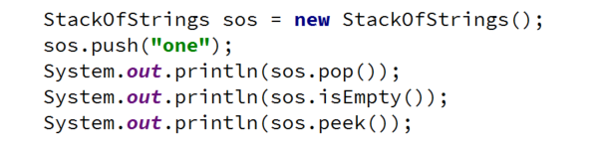
Problem: Stack of Strings
Create a simple Stack class which can store only strings
StackOfStrings
StackOfStrings
-data: List<String>
ArrayList
+push(String) :void
+pop(): String
+peek(): String
+isEmpty(): boolean
<number>
Notes:
(c) 2005 National Academy for Software Development - http://academy.devbg.org. All rights reserved. Unauthorized copying or re-distribution is strictly prohibited.(c) 2006 National Academy for Software Development - http://academy.devbg.org*
<number>##
Extensibility / Polymorphism: New functionality may be easily plugged in without changing existing classes as long the new plug-in classes extend given base classes.
Reusability: For a set of similar applications a framework can be defined using a core set of classes that are to be extended by classes that fill in the application-dependent part.
Information Hiding: If a more general class using a simpler contract is sufficient, details from extending classes may be hidden to some of the client classes. This allows them to be more independent from possible changes and diminishes the load of contracts that must be understood by a reader of these client classes.
*
07/16/96
(c) 2006 National Academy for Software Development - http://academy.devbg.org*
<number>##

Slide 41
Solution: Stack of Strings
public class StackOfStrings {
private List<String> container;
public void push(String item)
{ this.container.add(item); }
public String pop()
{ return this.container
.remove(this.container.size() - 1); }
}
TODO: Validate if list is not empty
<number>
Notes:
(c) 2005 National Academy for Software Development - http://academy.devbg.org. All rights reserved. Unauthorized copying or re-distribution is strictly prohibited.(c) 2006 National Academy for Software Development - http://academy.devbg.org*
<number>##
Extensibility / Polymorphism: New functionality may be easily plugged in without changing existing classes as long the new plug-in classes extend given base classes.
Reusability: For a set of similar applications a framework can be defined using a core set of classes that are to be extended by classes that fill in the application-dependent part.
Information Hiding: If a more general class using a simpler contract is sufficient, details from extending classes may be hidden to some of the client classes. This allows them to be more independent from possible changes and diminishes the load of contracts that must be understood by a reader of these client classes.
*
07/16/96
(c) 2006 National Academy for Software Development - http://academy.devbg.org*
<number>##

Slide 42
When to Use Inheritance
Too simplistic
Classes share IS-A relationship
Derived class IS-A-SUBSTITUTE for the base class
Share the same role
Derived class is the same as the base class but adds a little bit more functionality
42
Notes:
(c) 2005 National Academy for Software Development - http://academy.devbg.org. All rights reserved. Unauthorized copying or re-distribution is strictly prohibited.(c) 2006 National Academy for Software Development - http://academy.devbg.org*
<number>##
Extensibility / Polymorphism: New functionality may be easily plugged in without changing existing classes as long the new plug-in classes extend given base classes.
Reusability: For a set of similar applications a framework can be defined using a core set of classes that are to be extended by classes that fill in the application-dependent part.
Information Hiding: If a more general class using a simpler contract is sufficient, details from extending classes may be hidden to some of the client classes. This allows them to be more independent from possible changes and diminishes the load of contracts that must be understood by a reader of these client classes.
*
07/16/96
(c) 2006 National Academy for Software Development - http://academy.devbg.org*
<number>##

Slide 43
Reusing Classes
Live Exercises in Class (Lab)
Notes:
<number>
© Software University Foundation – http://softuni.org
This work is licensed under the Creative Commons Attribution-NonCommercial-ShareAlike license.

Slide 44
Summary
Inheritance is a powerful tool for code reuse
Subclass inherits members from Superclass
Subclass can override methods
Look for classes with the same role
Look for IS-A and IS-A-SUBSTITUTE for relationship
Consider Composition and Delegation instead
<number>

Slide 45












Java OOP Basics – Inheritance
https://softuni.bg/modules/21/java-fundamentals
Notes:
© Software University Foundation – http://softuni.org
This work is licensed under the Creative Commons Attribution-NonCommercial-ShareAlike license.
<number>

Slide 46





Trainings @ Software University (SoftUni)
Software University – High-Quality Education, Profession and Job for Software Developers
softuni.bg
Software University Foundation
http://softuni.foundation/
Software University @ Facebook
facebook.com/SoftwareUniversity
Software University Forums
forum.softuni.bg
Notes:
© Software University Foundation – http://softuni.org
This work is licensed under the Creative Commons Attribution-NonCommercial-ShareAlike license.
<number>

